Slide 1


Ang Ke Wei
18/12/2022

Slide 2

Outline
Executive Summary
Introduction
Methodology
Results
Conclusion
Appendix

Slide 3
Executive Summary
Summary of methodologies
Data Collection through API
Data Collection with Web Scraping
Data Wrangling
Exploratory Data Analysis with SQL
Exploratory Data Analysis with Data Visualization
Interactive Visual Analytics with Folium
Machine Learning Prediction
Summary of all results
Exploratory Data Analysis result
Interactive analytics in screenshots
Predictive Analytics result

Slide 4
Introduction
Project background and context
Space X advertises Falcon 9 rocket launches on its website with a cost of 62 million dollars; other providers cost upward of 165 million dollars each, much of the savings is because Space X can reuse the first stage. Therefore, if we can determine if the first stage will land, we can determine the cost of a launch. This information can be used if an alternate company wants to bid against space X for a rocket launch. This goal of the project is to create a machine learning pipeline to predict if the first stage will land successfully.
Problems you want to find answers
What factors determine if the rocket will land successfully?
The interaction amongst various features that determine the success rate of a successful landing.
What operating conditions needs to be in place to ensure a successful landing program

Slide 5

Section 1

Slide 6
Methodology
Executive Summary
Data collection methodology:
Data was collected using SpaceX API and web scraping from Wikipedia
Perform data wrangling
One-hot encoding was applied to categorical features
Perform exploratory data analysis (EDA) using visualization and SQL
Perform interactive visual analytics using Folium and Plotly Dash
Perform predictive analysis using classification models
How to build, tune, evaluate classification models

Slide 7
Data Collection
Data collection was done using get request to the SpaceX API.
Next, we decoded the response content as a Json using .json() function call and turn it into a pandas dataframe using .json_normalize().
We then cleaned the data, checked for missing values and fill in missing values where necessary.
In addition, we performed web scraping from Wikipedia for Falcon 9 launch records with BeautifulSoup.
The objective was to extract the launch records as HTML table, parse the table and convert it to a pandas dataframe for future analysis

Slide 8
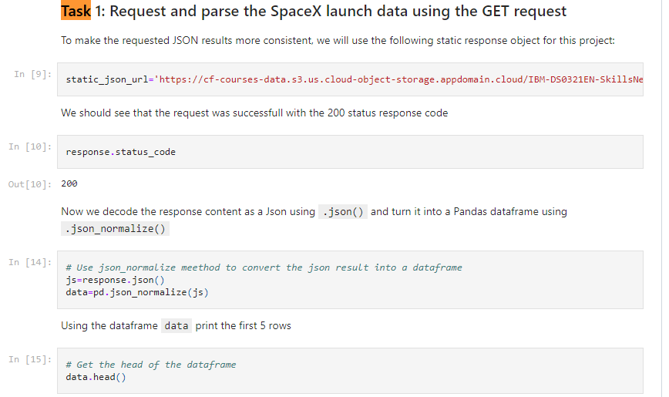
Data Collection – SpaceX API
We used the get request to the SpaceX API to collect data, clean the requested data and did some basic data wrangling and formatting.
https://github.com/keweiang/IBM-Data-Science-Capstone-SpaceX/blob/main/data-collection-api%20(1).ipynb

Slide 9
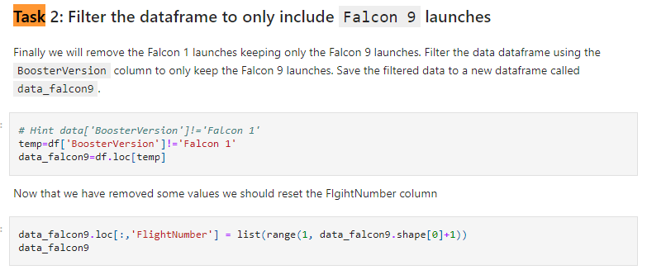
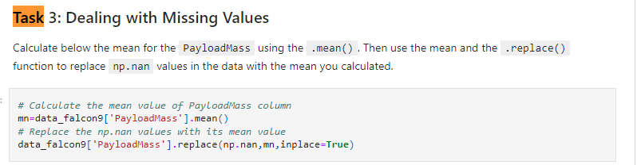
Data Collection – SpaceX API (continue)

Slide 10

Data Collection - Scraping
We applied web scrapping to webscrap Falcon 9 launch records with BeautifulSoup
We parsed the table and converted it into a pandas dataframe.
Link: https://github.com/keweiang/IBM-Data-Science-Capstone-SpaceX/blob/main/Data%20collection%20-%20web%20scraping.ipynb

Slide 11
Data Wrangling
We performed exploratory data analysis and determined the training labels.
We calculated the number of launches at each site, and the number and occurrence of each orbits
We created landing outcome label from outcome column and exported the results to csv.
Link: https://github.com/keweiang/IBM-Data-Science-Capstone-SpaceX/blob/main/Data%20Wrangling.ipynb

Slide 12
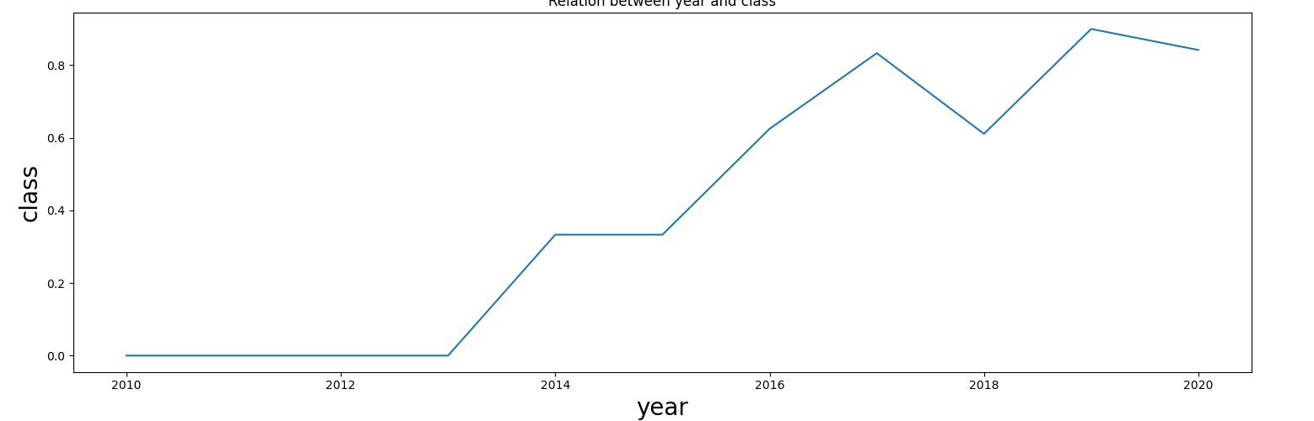
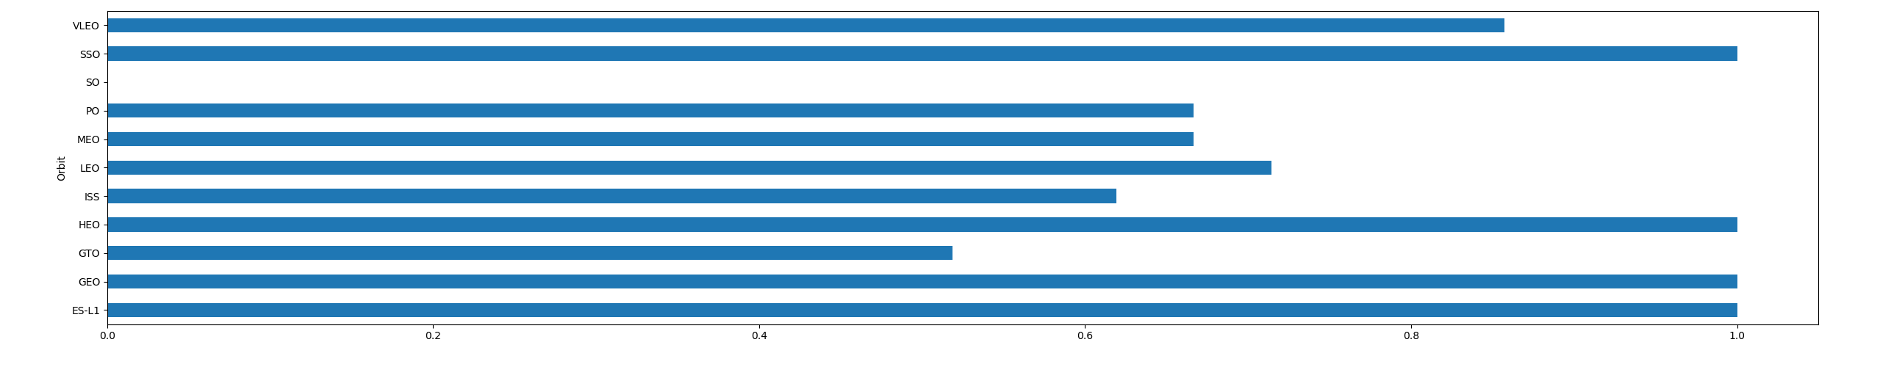
EDA with Data Visualization
We explored the data by visualizing the relationship between flight number and launch Site, payload and launch site, success rate of each orbit type, flight number and orbit type, the launch success yearly trend.
Link: https://github.com/keweiang/IBM-Data-Science-Capstone-SpaceX/blob/main/EDA%20with%20visualization.ipynb

Slide 13
EDA with SQL
We loaded the SpaceX dataset into a PostgreSQL database without leaving the jupyter notebook.
We applied EDA with SQL to get insight from the data. We wrote queries to find out for instance:
The names of unique launch sites in the space mission.
The total payload mass carried by boosters launched by NASA (CRS)
The average payload mass carried by booster version F9 v1.1
The total number of successful and failure mission outcomes
The failed landing outcomes in drone ship, their booster version and launch site names.
The link to the notebook is https://github.com/keweiang/IBM-Data-Science-Capstone-SpaceX/blob/main/EDA%20with%20SQL.ipynb

Slide 14
Build an Interactive Map with Folium
We marked all launch sites, and added map objects such as markers, circles, lines to mark the success or failure of launches for each site on the folium map.
We assigned the feature launch outcomes (failure or success) to class 0 and 1.i.e., 0 for failure, and 1 for success.
Using the color-labeled marker clusters, we identified which launch sites have relatively high success rate.
We calculated the distances between a launch site to its proximities. We answered some question for instance:
Are launch sites near railways, highways and coastlines.
Do launch sites keep certain distance away from cities.

Slide 15
Build a Dashboard with Plotly Dash
We built an interactive dashboard with Plotly dash
We plotted pie charts showing the total launches by a certain sites
We plotted scatter graph showing the relationship with Outcome and Payload Mass (Kg) for the different booster version.
The link to the notebook is https://github.com/keweiang/IBM-Data-Science-Capstone-SpaceX/blob/main/app.py

Slide 16
Predictive Analysis (Classification)
We loaded the data using numpy and pandas, transformed the data, split our data into training and testing.
We built different machine learning models and tune different hyperparameters using GridSearchCV.
We used accuracy as the metric for our model, improved the model using feature engineering and algorithm tuning.
We found the best performing classification model.
The link to the notebook is https://github.com/keweiang/IBM-Data-Science-Capstone-SpaceX/blob/main/Machine%20Learning%20Prediction.ipynb

Slide 17
Results
Exploratory data analysis results
Interactive analytics demo in screenshots
Predictive analysis results

Slide 18

Section 2

Slide 19
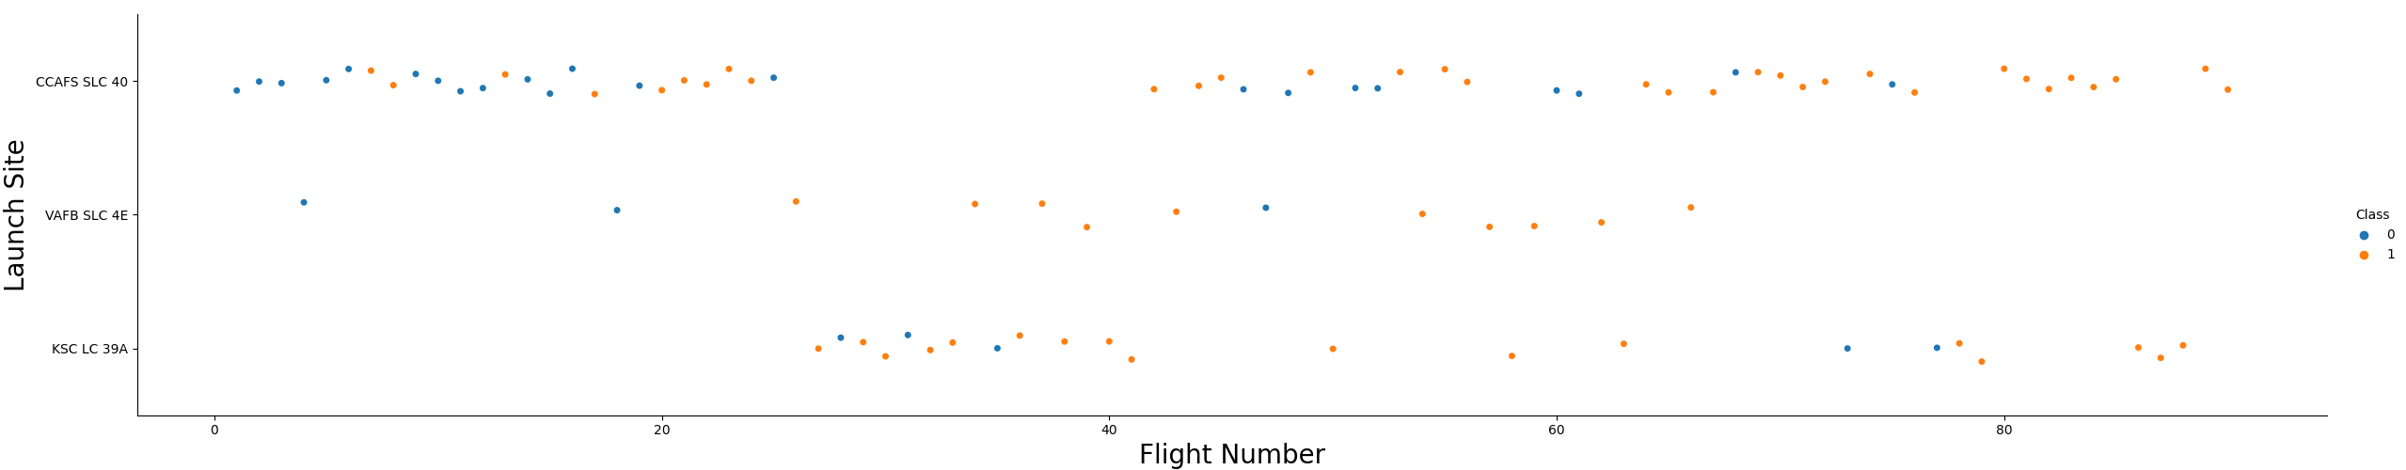
Flight Number vs. Launch Site
From the plot, the larger the flight amount at a launch site, the larger the success rate at a launch site.

Slide 20
Payload vs. Launch Site
The greater the payload mass for launch site CCAFS SLC 40, the higher the success rate for the rocket.

Slide 21
Success Rate vs. Orbit Type
ES-L1, GEO, HEO, VLEO had the most success rate.

Slide 22
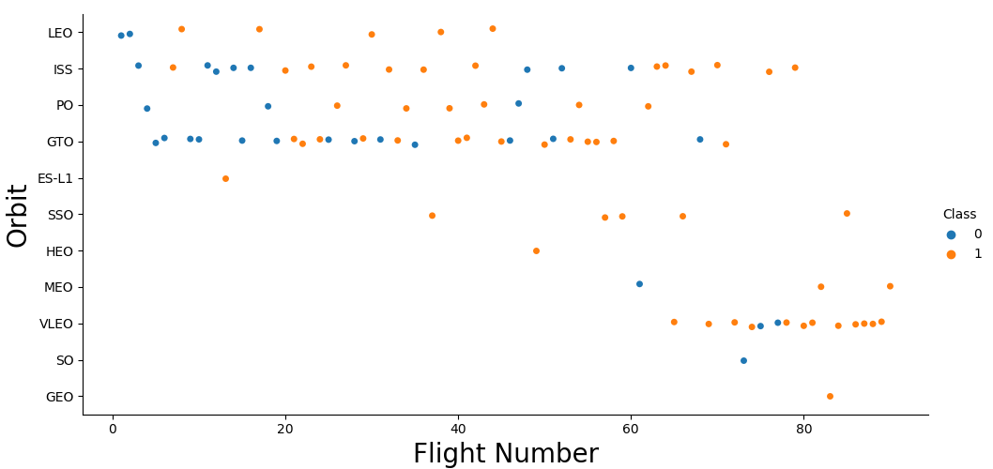
Flight Number vs. Orbit Type
From the plot, we found that in LEO orbit, success is related to the number of flights whereas in GTO orbit, no relationship between flight number and orbit.

Slide 23
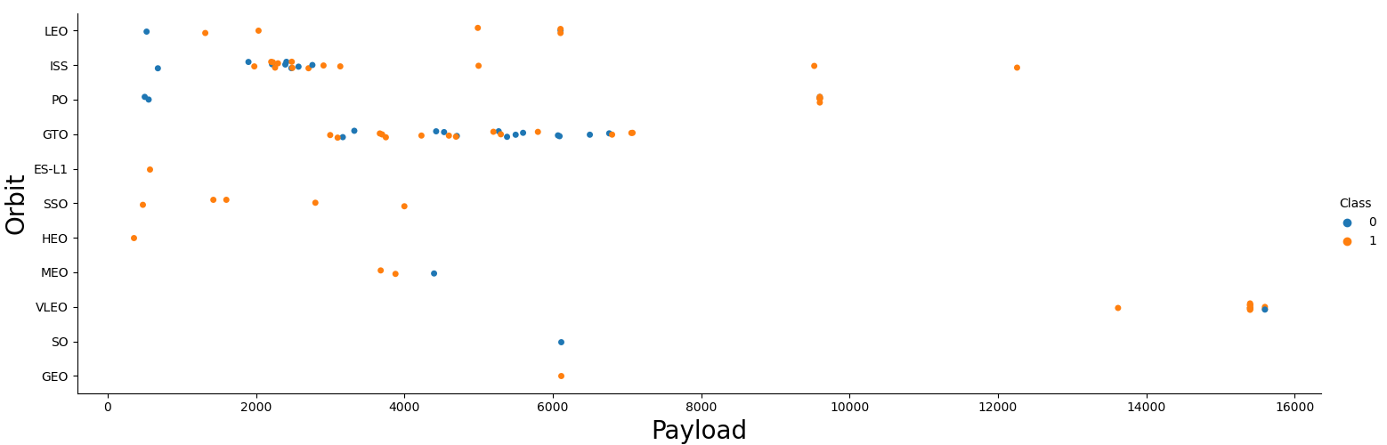
Payload vs. Orbit Type
We observe that for heavy payloads, the successful landing are more for PO, LEO, and ISS orbits.

Slide 24
Launch Success Yearly Trend
Increasing pattern is shown since 2013 until 2017, and continued from 2018 to 2019.

Slide 25
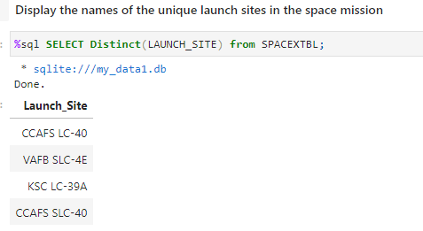
All Launch Site Names
DISTINCT function is used to show unique launch sites from SpaceX data.

Slide 26
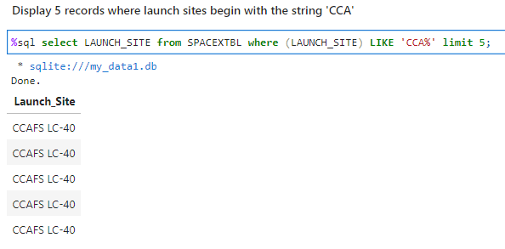
Launch Site Names Begin with 'CCA'
The query in the figure show how we display the 5 records of launch site name starts with ‘CCA’.

Slide 27
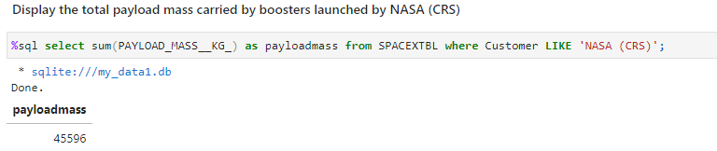
Total Payload Mass
The total payload is 45596 kg.

Slide 28
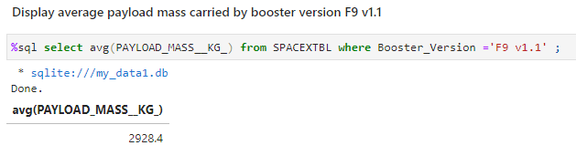
Average Payload Mass by F9 v1.1
The average payload is 2928.4 kg.

Slide 29
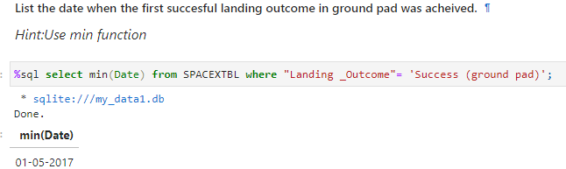
First Successful Ground Landing Date
The first successful landing outcome on ground pad was 01 May 2017.

Slide 30
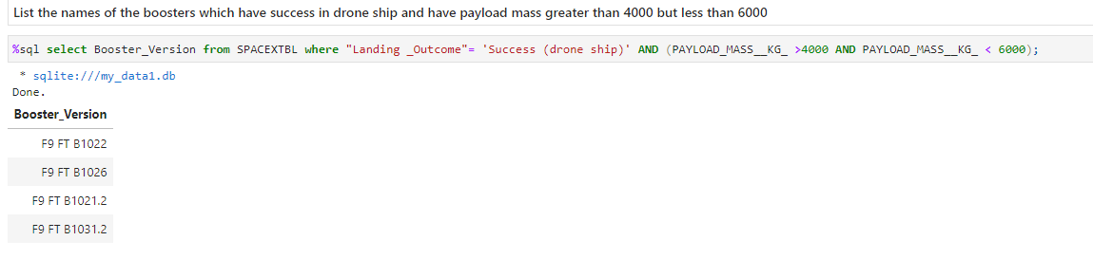
Successful Drone Ship Landing with Payload between 4000 and 6000
WHERE is used to filter boosters which have successfully landed on drone ship while AND is used to determine payload mass that are between 4000 to 6000.

Slide 31
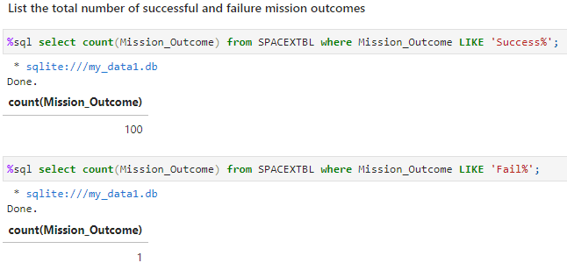
Total Number of Successful and Failure Mission Outcomes
WHERE is used to filter Mission_Outcome that was success or failure.

Slide 32
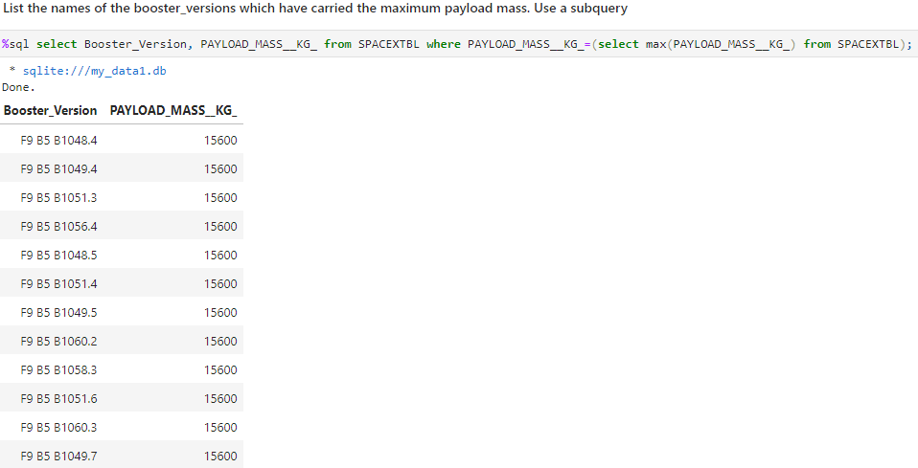
Boosters Carried Maximum Payload
MAX function is used in WHERE to get the maximum payload and booster_versions.

Slide 33
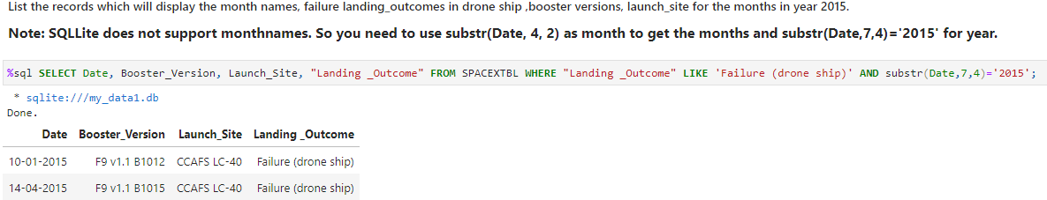
2015 Launch Records
WHERE, LIKE, AND and BETWEEN are used to filter failed landing outcomes in drone ship, their booster versions and launch sites names for 2015.

Slide 34
Rank Landing Outcomes Between 2010-06-04 and 2017-03-20
Rank the count of landing outcomes (such as Failure (drone ship) or Success (ground pad)) between the date 2010-06-04 and 2017-03-20, in descending order using WHERE, COUNT, AND, BETWEEN function.

Slide 35

Section 3

Slide 36

All launch sites global map markers

Slide 37

Markers showing launch sites with color labels

Slide 38

Launch Site distance to landmarks

Slide 39

Section 4

Slide 40

Pie chart showing the success percentage achieved by each launch site

Slide 41

Pie chart showing the Launch site with the highest launch success ratio

Slide 42

Scatter plot of Payload vs Launch Outcome for all sites, with different payload selected in the range slider

Slide 43

Section 5

Slide 44

Classification Accuracy
The decision tree classifier is the model with the highest classification accuracy

Slide 45

Confusion Matrix
The confusion matrix for the decision tree classifier shows that the classifier can distinguish between the different classes. The major problem is the false positives .i.e., unsuccessful landing marked as successful landing by the classifier.

Slide 46
Conclusions
We can conclude that:
The larger the flight amount at a launch site, the greater the success rate at a launch site.
Launch success rate started to increase in 2013 till 2020.
Orbits ES-L1, GEO, HEO, SSO, VLEO had the most success rate.
KSC LC-39A had the most successful launches of any sites.
The Decision tree classifier is the best machine learning algorithm for this task.

Slide 47


